Slide 1
Principles of Database Systems (CS307) Lecture 3: Retrieving Data from One Table
Ran Cheng
Department of Computer Science and Engineering
Southern University of Science and Technology
Most contents are from slides made by Stéphane Faroult, Dr Yuxin Ma and the authors of Database System Concepts (7th Edition).
Their original slides have been modified to adapt to the schedule of CS307 at SUSTech.

Slide 2
Select
select * from tablename
The select clause lists the attributes desired in the result of a query
To display the full content of a table, you can use select *
* : all columns
select A1, A2, ..., An from r1, r2, ..., rm where P

Slide 3
Select
select * from tablename
The select clause lists the attributes desired in the result of a query
To display the full content of a table, you can use select *
* : all columns
select A1, A2, ..., An from r1, r2, ..., rm where P
Such a query is frequently used in interactive tools (especially when you don't remember column names ...)
But you should not use it, though, in application programs

Slide 4
Restrictions
When tables contains thousands or millions or billions of rows, you are usually interested in only a small subset, and only want to return some of the rows
peopleid | first_name | surname | born | died
Notes:
When tables contain huge number of rows, you are usually interested with only a small subset. And only want to return some of the rows.

Slide 5
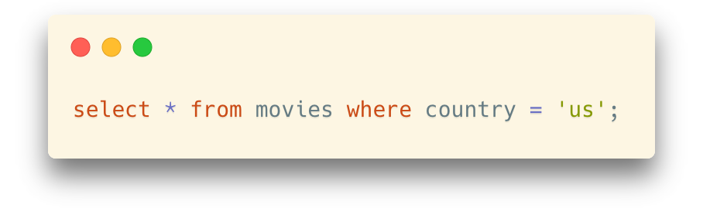
Restrictions
Filtering
Performed in the “where” clause
Conditions are usually expressed by a column name
… followed by a comparison operator and the value to which the content of the column is compared
Only rows for which the condition is true will be returned
Notes:
You can use WHERE clause for filtering.
Here the condition is the column value should be ‘us’. Only rows where the condition is true will be returned.

Slide 6
Comparison
You can compare to:
a number
a string constant
another column (from the same table or another, we'll see queries involving several tables later)
the result of a function (we'll see them soon)

Slide 7
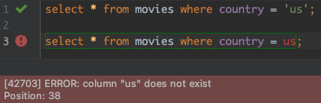
String Constants
Be aware that string constants must be quoted between single-quotes
If they are NOT quoted, they will be interpreted as column names
* Same thing with Oracle if they are double-quoted

Slide 8
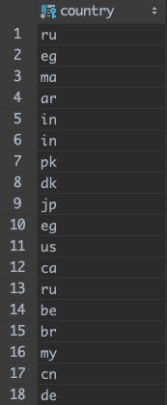
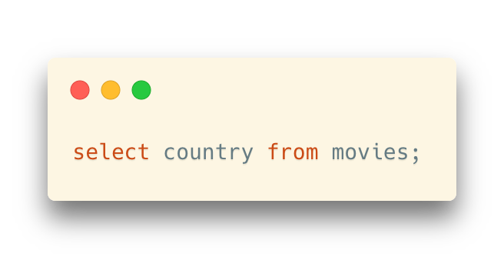
Filtering
Note that a filtering condition returns a subset
However, if you return some column(s) from a table, there can be duplicates

Slide 9
Select without From or Where
An attribute can be a literal without from clause
select '437’
It returns a table with one column and a single row with value “437”
You can give the column a name using:
select '437' as FOO
An attribute can be a literal with from clause
select 'A’ from movies
It returns a table with one column and N rows (number of tuples/rows in the movies table), each row with value “A”

Slide 10
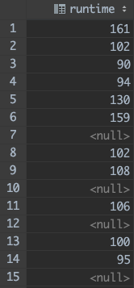
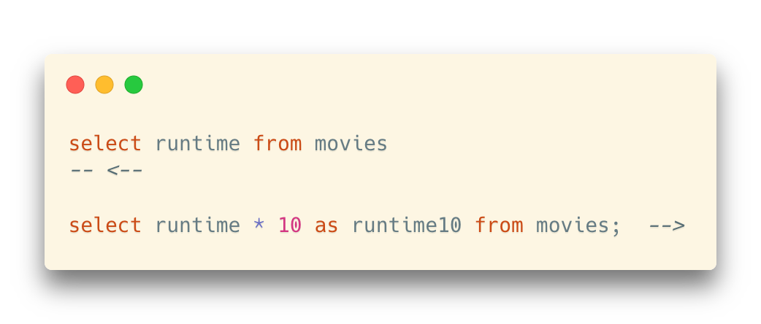
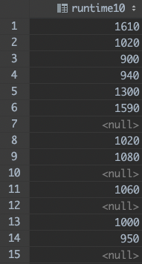
Arithmetic Expression
The select clause can contain arithmetic expressions involving the operation, +, –, *, and /, and operating on constants or attributes of tuples

Slide 11
Arithmetic Expression
The select clause can contain arithmetic expressions involving the operation, +, –, *, and /, and operating on constants or attributes of tuples
as clause:
Rename the column

Slide 12
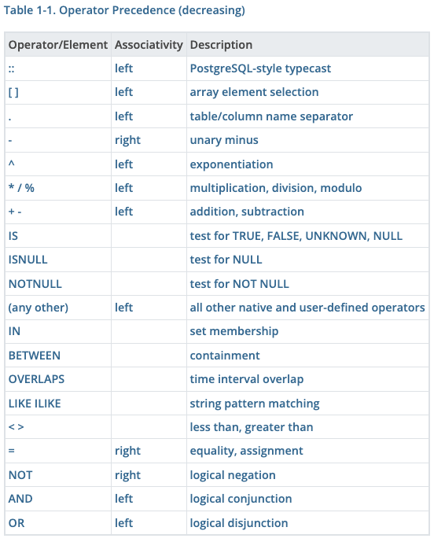
Logical Connectives
and, or, not
Just like in programming languages
All logical operators have different precedence
For example, and has a higher priority than or.
https://www.postgresql.org/docs/7.2/sql-precedence.html

Slide 13
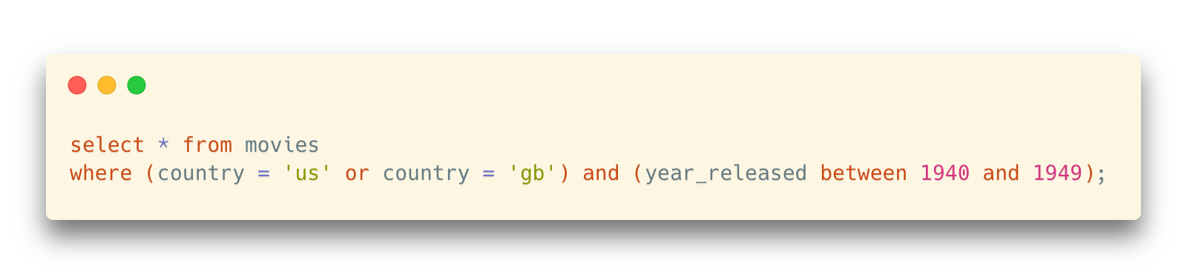
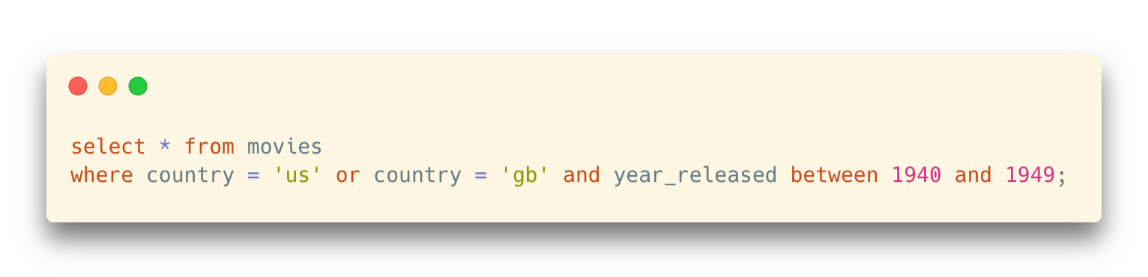
Logical Connectives
and, or, not
Just like in programming languages
All logical operators have different precedence
For example, and has a higher priority than or.
Differences?

Slide 14

Logical Connectives
Use parentheses to specify that the or should be evaluated before the and, and that the conditions filter
1) British or American films
2) That were released in the 1940s

Slide 15
Logical Connectives
Question:
Find the Chinese movies from the 1940s and American movies from the 1950s

Slide 16
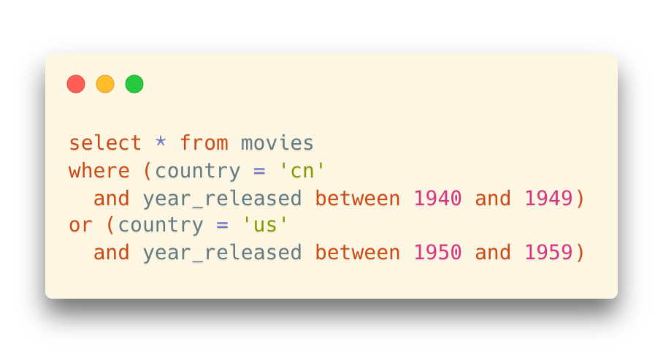
Logical Connectives
Question:
Find the Chinese movies from the 1940s and American movies from the 1950s
In this case parentheses are optional – but they don't hurt
The parentheses make the statement easier to understand

Slide 17
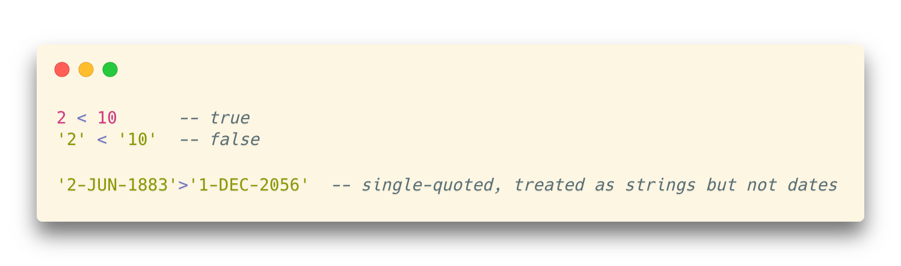
Logical Connectives
The operands of the logical connectives can be expressions involving the comparison operators <, <=, >, >=, =, and <>.
Note that there are two ways to write “not equal to”: != and <>
Comparisons can be applied to results of arithmetic expressions
Beware that "bigger" and "smaller" have a meaning that depends on the data type
It can be tricky because most products implicitly convert one of the sides in a comparison between values of differing types
Notes:
You can use all the comparison operators.
Equal, not equal, less than, greater than, less or equal than, greater or equal than.
You have two ways to write different.

Slide 18
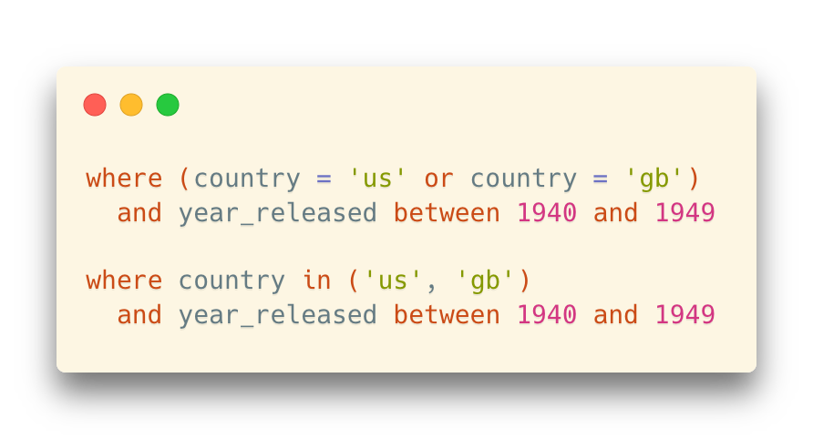
Logical Connectives
in()
It can be used as the equivalent for a series of equalities with OR
It may make a comparison clearer than a parenthesized expression

Slide 19
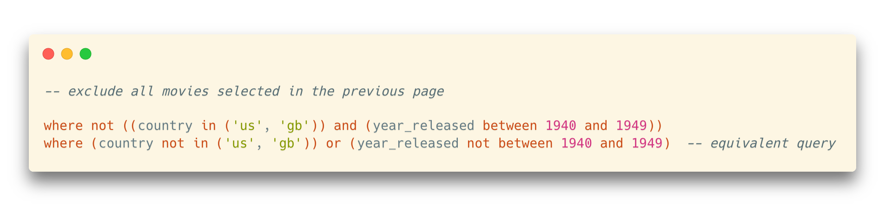
Logical Connectives
Negation
All comparisons can be negated with NOT

Slide 20
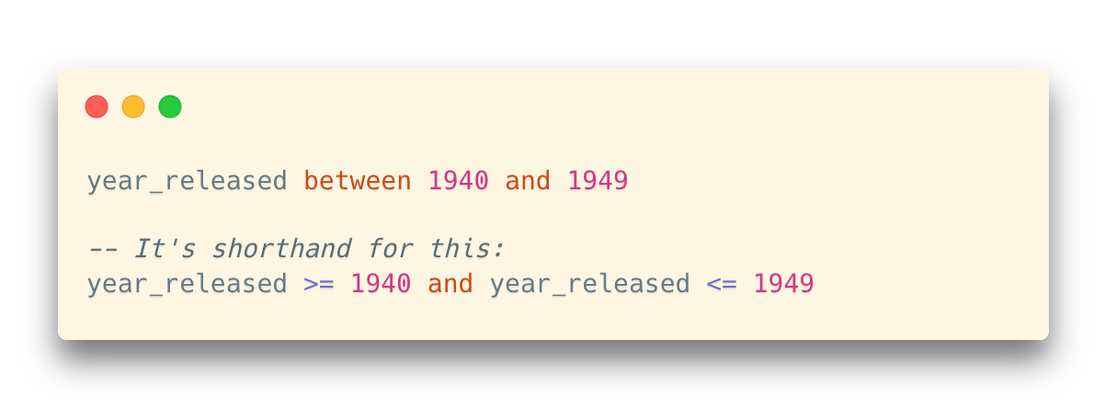
between Comparison Operator
between … and …
shorthand for: >= and <=

Slide 21
between Comparison Operator
between … and …
shorthand for: >= and <= （闭区间）
not “<”

Slide 22
like
For strings, you also have like which is a kind of regex (regular expression) for dummies (仿冒品).
like compares a string to a pattern that can contain two wildcard characters:
% meaning "any number of characters, including none”
_ meaning "one and only one character"

Slide 23
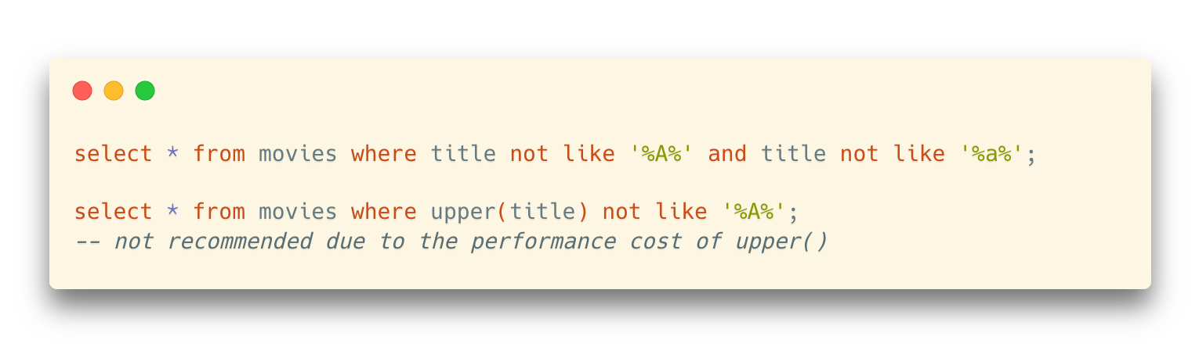
like
This expression for instance returns films the title of which doesn't contain any A
This A might be the first or last character as well
Note that if the DBMS is case sensitive, you need to cater both for upper and lower case
Function calls could slow down queries; use with caution

Slide 24
Date
Date formats
Beware also of date formats, and of conflicting European/American formats which can be ambiguous for some dates. Common problem in multinational companies.
DD/MM/YYYY
MM/DD/YYYY
YYYY/MM/DD

Slide 25
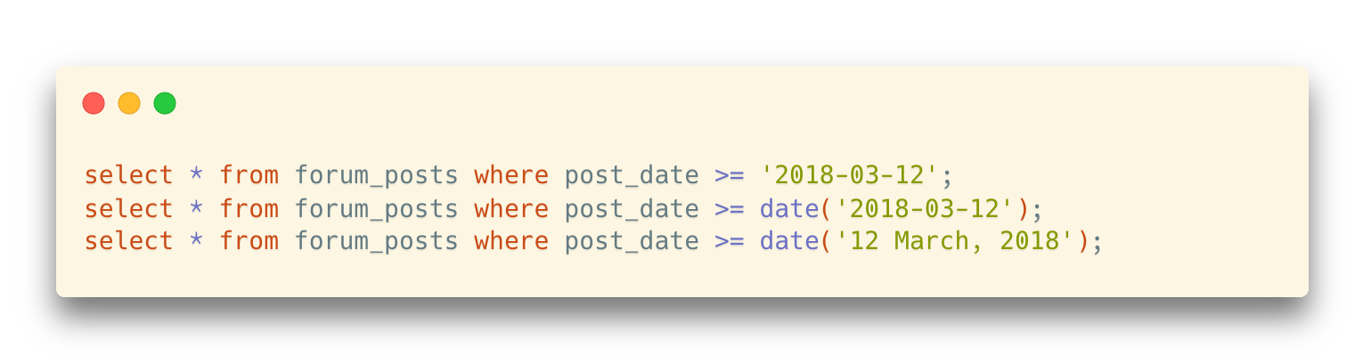
Date
Whenever you are comparing data of slightly different types, you should use functions that "cast" data types
It will avoid bad surprises
The functions don't always bear the same names but exist with all products
Default formats vary by product, and can often be changed at the DBMS level
So, better to use explicit date types and functions other than strings
Conversely, you can format something that is internally stored as a date and turn it into a character string that has almost any format you want
Notes:
When we compare data of slightly different types, SQL can help us to convert the type automatically.
Such as in this example, the type of post_date is Date. But the SQL statement can run without error and return the results expected.
But It’s better to convert the type explicitly. As in this statement. We use function date to convert the string to Date type.
If we use March nor 03, it will be better, I think.
There is no practical way to enter a date as a string. You need to convert the string to a Date or Datetime format, and then store into a database.
If you want, you can store the date as a character string into a database, but it’s not good for the DBMS to manage the data, such as to compare different dates.

Slide 26
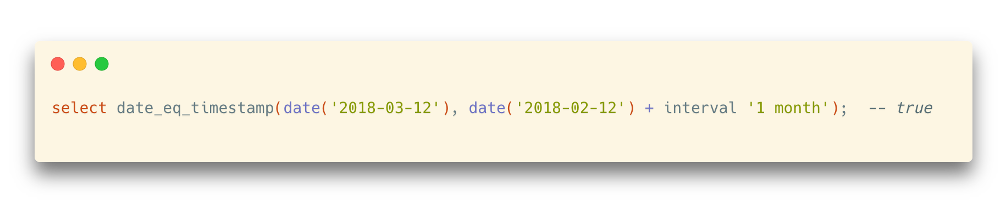
Date and Datetime
If you compare datetime values to a date (without any time component) the SQL engine will not understand that the date part of the datetime should be equal to that date
Rather, it will consider that the date that you have supplied is actually a datetime, with the time component that you can read below
date(‘2020-03-20’) is equal to datetime(‘2020-03-20 00:00:00’)
Date functions
Many useful date functions when manipulating date and datetime values
However, most of them are DBMS-dependent

Slide 27
NULL
In a language such as Java, you can compare a reference to null, because null is defined as the ‘0’ address.
In C, you can also compare a pointer to NULL (pointer is C-speak for reference)

Slide 28
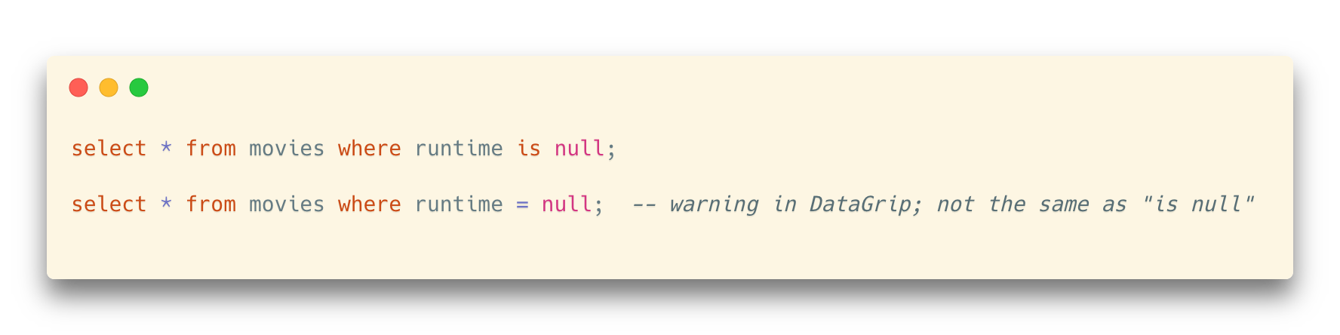
NULL
Not in SQL, where NULL denotes that a value is missing
NULL in SQL is not a value
… and if it's not a value, hard to say if a condition is true.
A lot of people talk about "null values", but they have it wrong
Most expression with NULL is evaluated to NULL

Slide 29
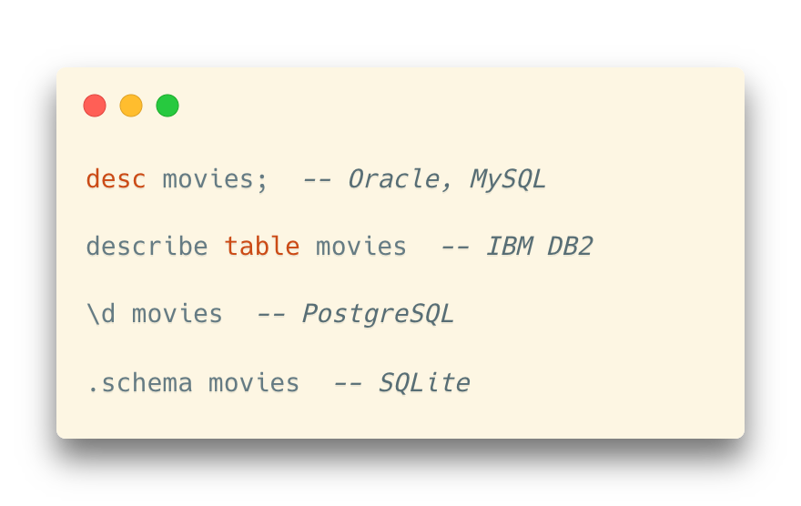
Some Functions
Show DDL of a table

Slide 30
Some Functions – Compute and Derive
One important feature of SQL is that you don’t need to return data exactly as it was stored
Operators, and many (mostly DBMS specific) functions allow to return transformed data

Slide 31
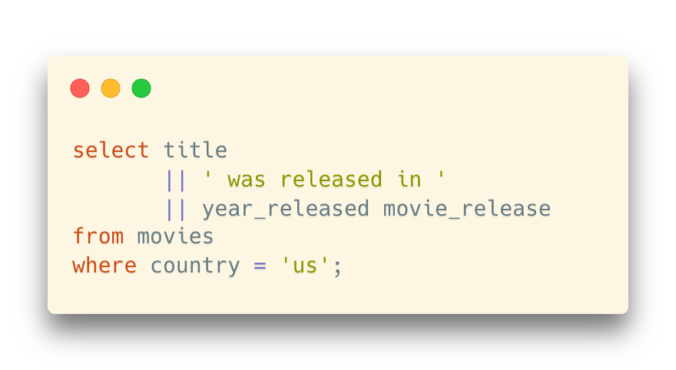
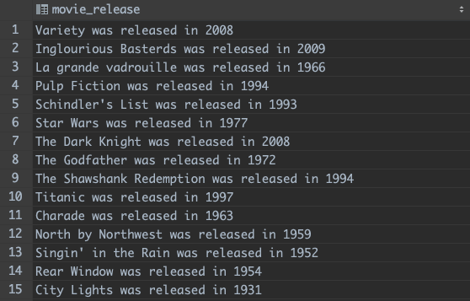
Some Functions
A simple transformation is concatenating two strings together
Most products use || (two vertical bars) to indicate string concatenation
SQL Server, though, uses +, and MySQL a special concat() function that also exists in some other products

Slide 32
Some Functions
A simple transformation is concatenating two strings together
Most products use || (two vertical bars) to indicate string concatenation
SQL Server, though, uses +, and MySQL a special concat() function that also exists in some other products
Note that you can give a name to an expression
This will be used as column header
It also becomes a "virtual column" if you turn the query into a "virtual table"

Slide 33
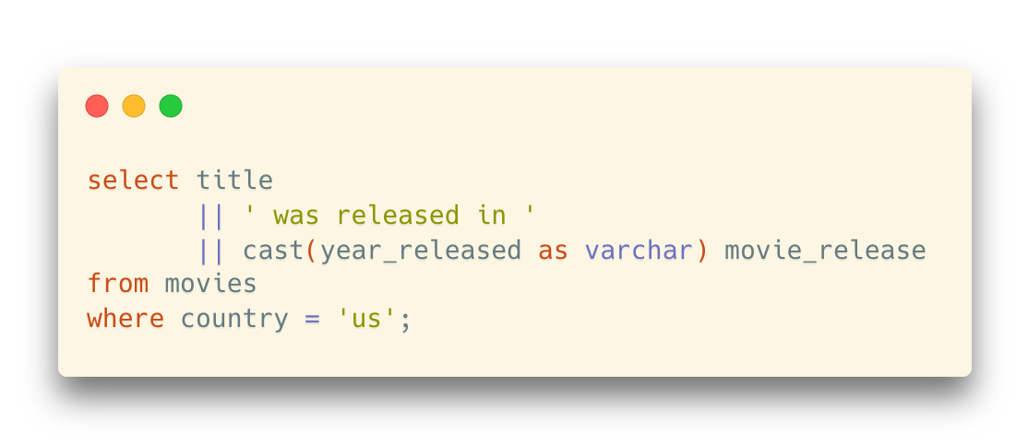
Some Functions
A simple transformation is concatenating two strings together
Most products use || (two vertical bars) to indicate string concatenation
SQL Server, though, uses +, and MySQL a special concat() function that also exists in some other products
Although YEAR_RELEASED is actually a number, it's implicitly turned into a string by the DBMS.
In that case it's not a big issue, but it would be better to use a function to convert explicitly.

Slide 34
Some Functions
When to use functions
An example of showing a result that isn't stored as such is computing an age
You should never store an age; it changes all the time!
If you want to display the age of people who are alive, you must compute their age by subtracting the year when they were born from the current year.

Slide 35
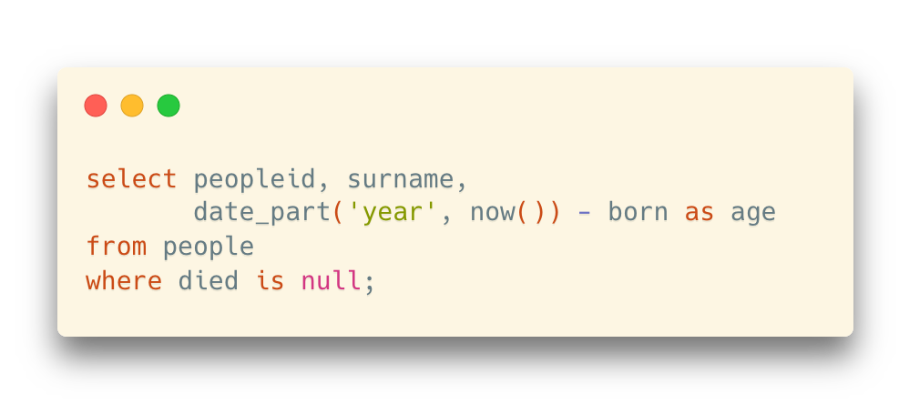
Some Functions
When to use functions
An example of showing a result that isn't stored as such is computing an age
You should never store an age; it changes all the time!
If you want to display the age of people who are alive, you must compute their age by subtracting the year when they were born from the current year.
In the table people:
Alive – died is null
Age: <this year> - born

Slide 36
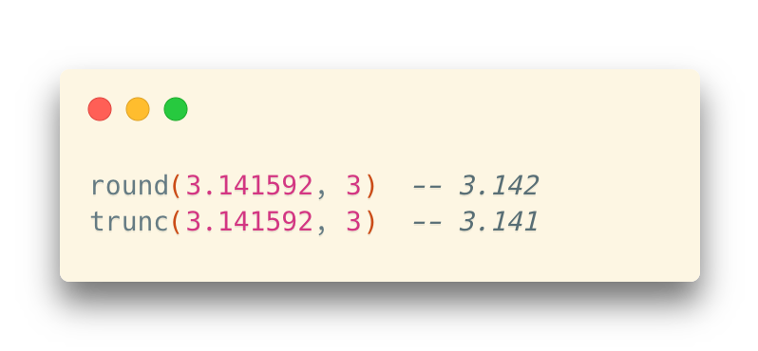
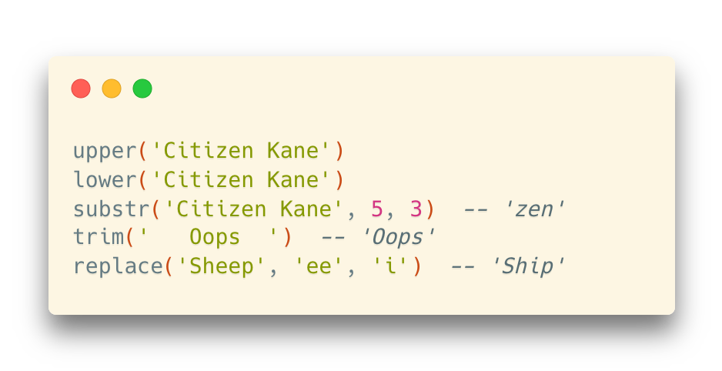
Some Functions
Numerical functions
More string functions
Notes:
I will introduce some useful function. Round is one.
It can round 3.141592 with 3 digits after the point,
If we use trunc, it is slightly different with round(). It will remove the rest part directly, no round operation.

Slide 37
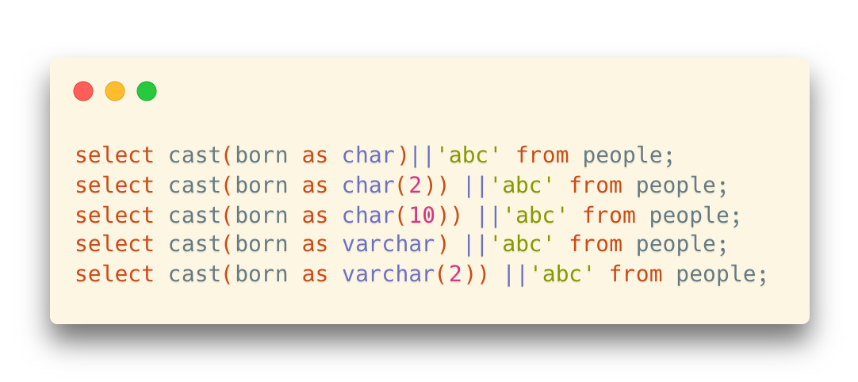
Some Functions
Type casting
cast(column as type)

Slide 38
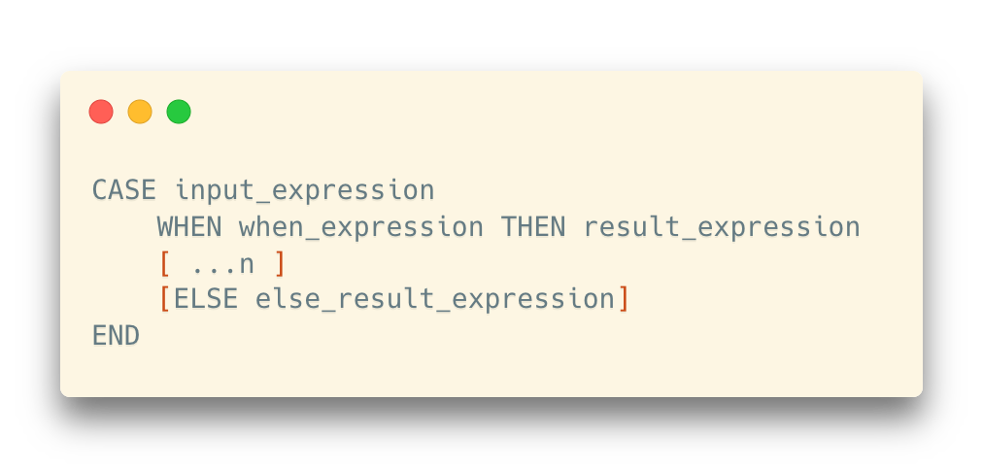
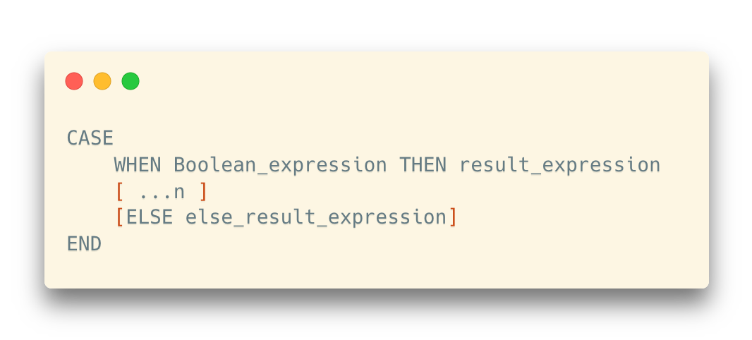
Case
A very useful construct is the CASE ... END construct that is similar to IF or SWITCH statements in a program
Notes:
Values are tested against a number of values and something else (which may be a computation, or even the content of other columns from the same row) is returned instead. If no match is found and there is no ELSE, the SQL engine doesn't know what to return, and returns NULL.

Slide 39
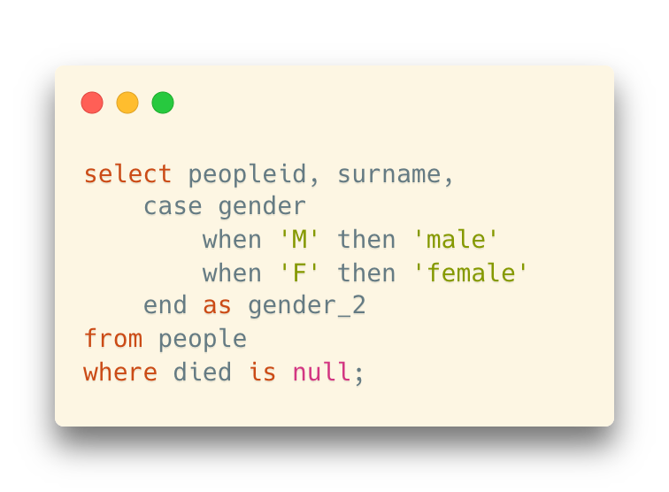
Case
Example 1: Show the corresponding words of the gender abbreviations
*Similar to the switch-case statement in Java and C

Slide 40
Case
Example 2: Decide whether someone’s age is older/younger than a pivot

Slide 41
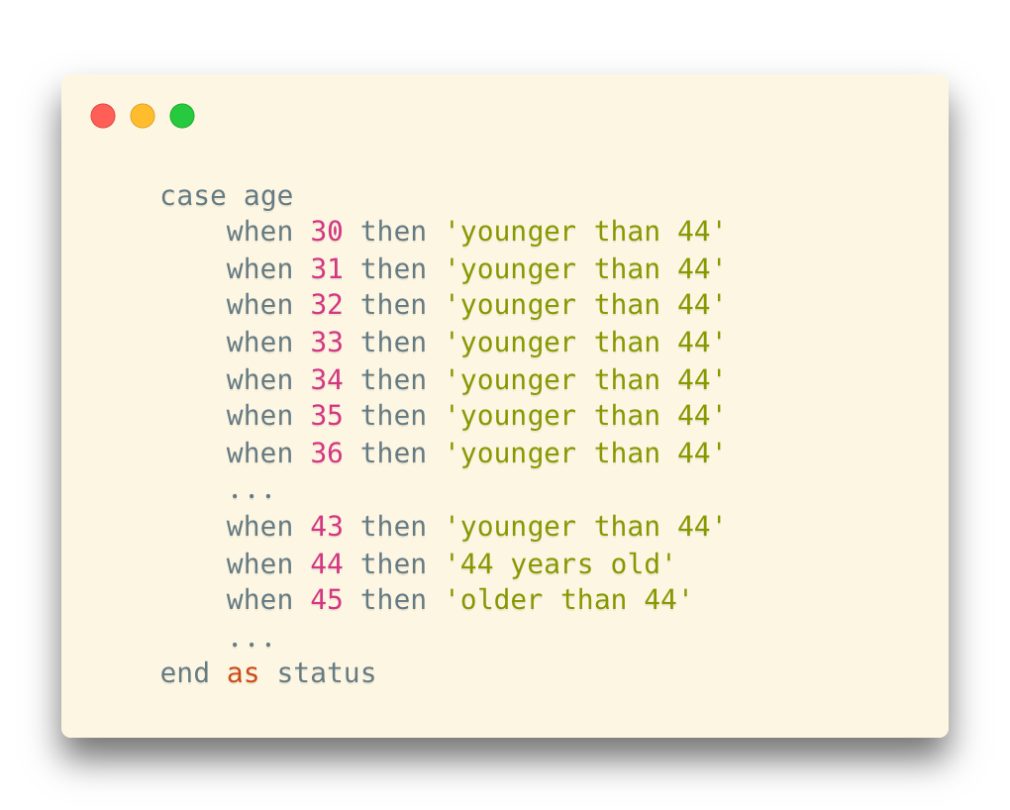
Case
Example 2: Decide whether someone’s age is older/younger than a pivot
A horrible solution!

Slide 42
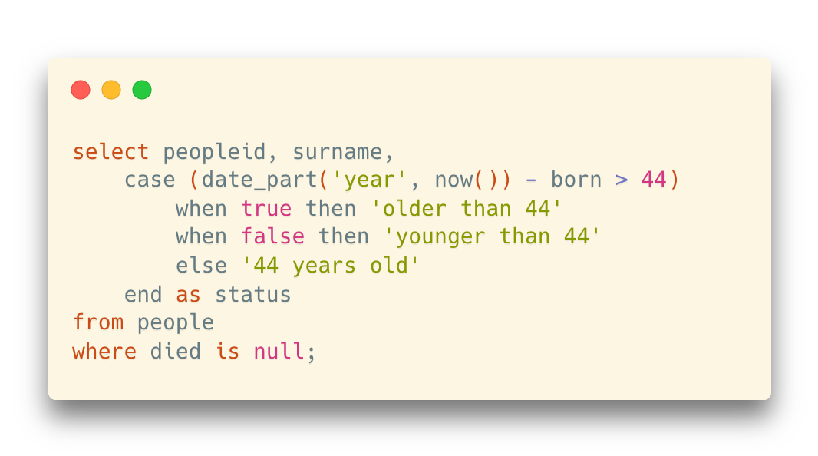
Case
Example 2: Decide whether someone’s age is older/younger than a pivot
CASE

Slide 43
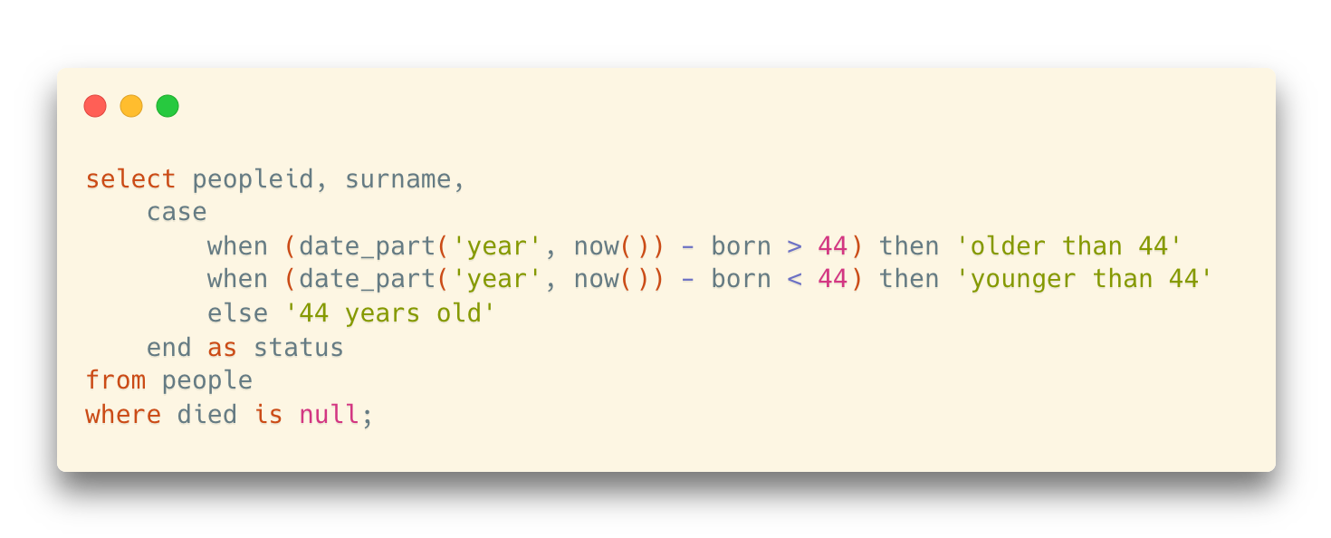
Case
Example 2: Decide whether someone’s age is older/younger than a pivot
CASE
CASE WHEN

Slide 44
Case
Example 2: Decide whether someone’s age is older/younger than a pivot
CASE
CASE WHEN
The ELSE branch
Return a default value when all when criteria are not met
If no else, NULL will be returned

Slide 45
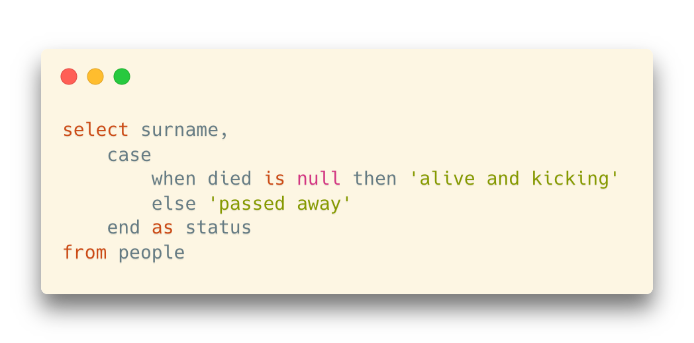
Case
About the NULL value
Use the “is null” criteria

